Slide 1



GOOGLE CLOUD x GEMINI AI HACKATHON — COLUMBIA UNIVERSITY
What if you could speak
a movie into existence?
Dream Studio
Real-time voice & vision story director powered by Gemini
<5s
5
100%
per scene
AI models
voice-driven
Gemini 2.5 Flash
Imagen 4
Veo 3.1
Lyria 2
Google ADK
1 / 10

Slide 2




The Problem
Storytelling is still stuck in the 20th century
Weeks
to produce even a short concept film — from script to storyboard to soundtrack
$10K+
minimum to hire artists, composers, and video editors for a single project
Zero
tools combine voice, camera, image gen, video gen, and music gen in real-time
The gap: 85% of creators want AI-powered storytelling tools, but current options are fragmented, complex, and text-only.
2 / 10

Slide 3

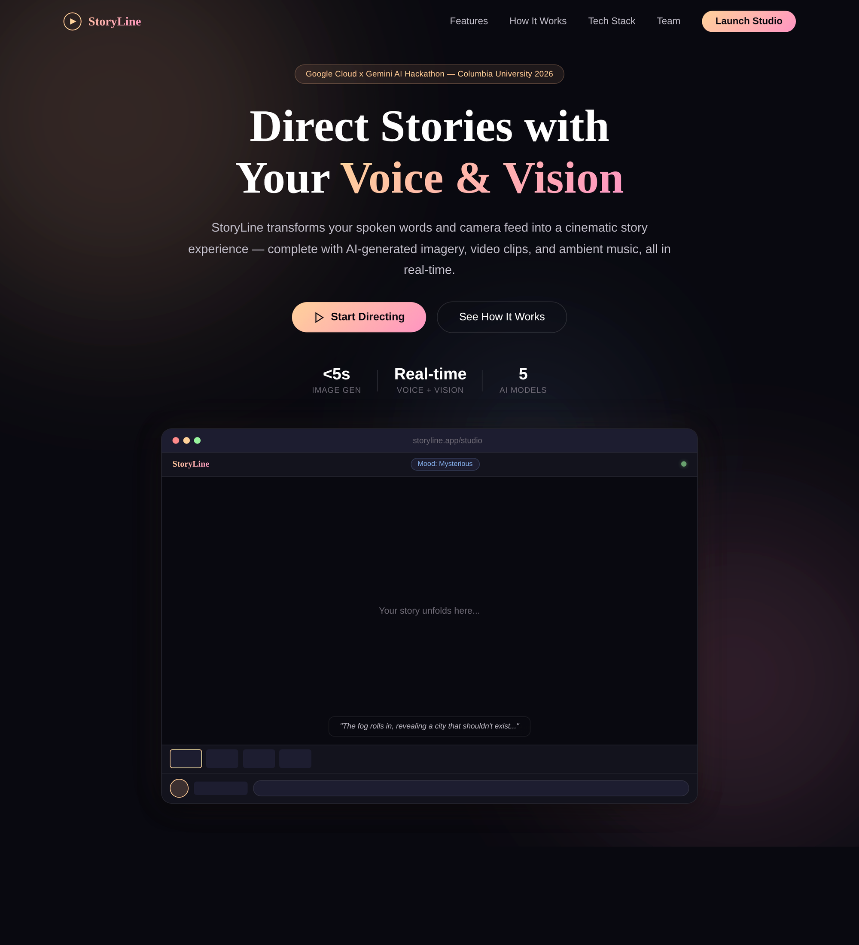
The Solution
Dream Studio : just speak and show. AI generates a complete cinematic story with images, video, music, and narration in real-time.
storyline.app
3 / 10

Slide 4

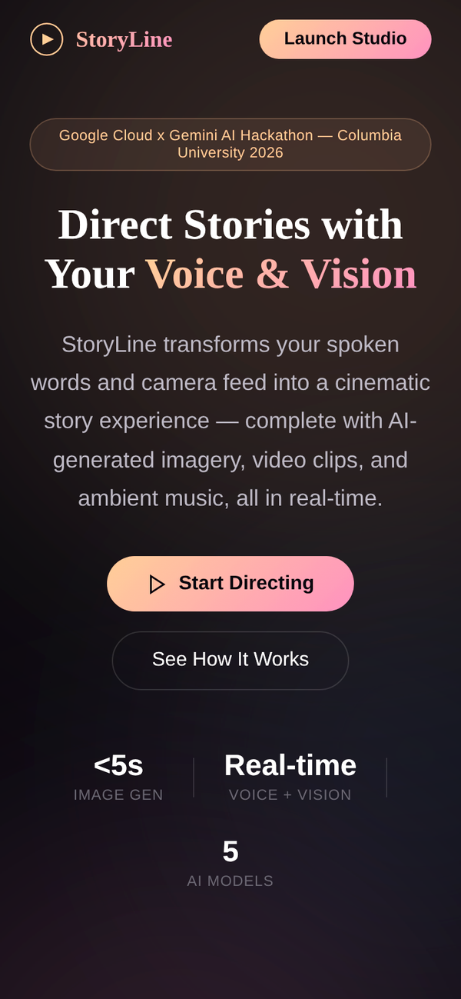
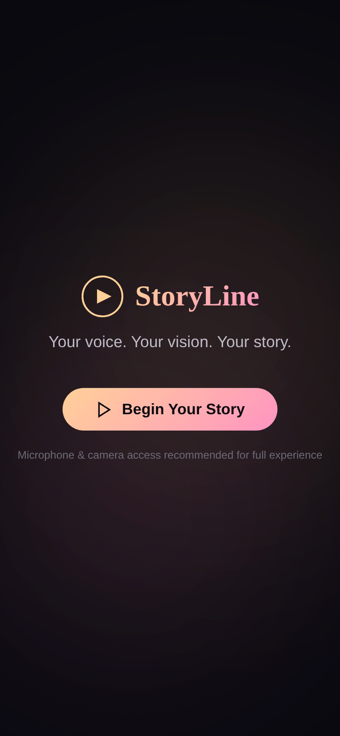
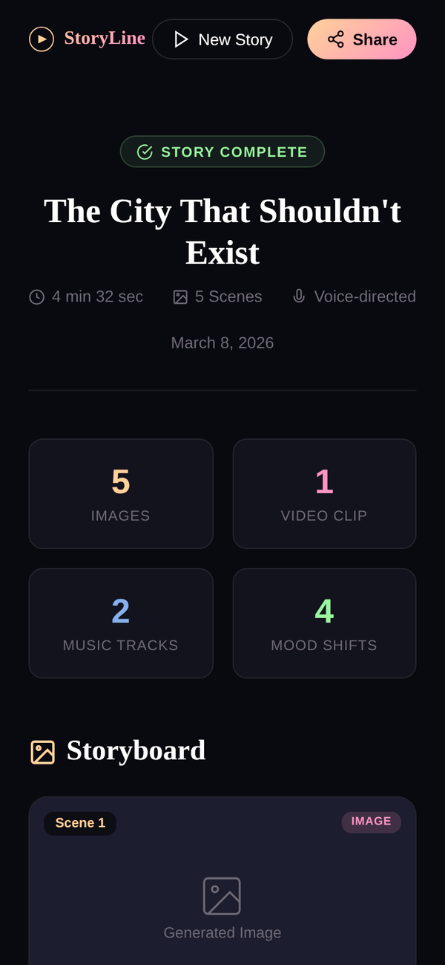

Live Demo
Land
Create
Review
Discover StoryLine
Speak & direct your story
Complete storyboard output
4 / 10

Slide 5
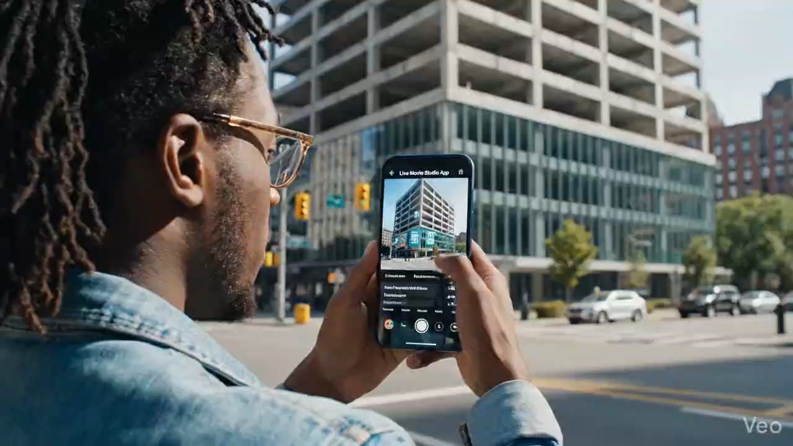
Live Demo

Slide 6




How It Works
From imagination to cinematic story in under 5 minutes
1
2
3
4
You Speak
Gemini Listens
AI Creates
Story Complete
Narrate your story naturally. Show objects via camera for visual context.
Native audio model processes voice + vision in real-time bidi stream.
Imagen 4 renders scenes. Veo 3.1 generates video. Lyria 2 composes music.
Full storyboard with images, video clips, soundtrack, and narration.
5 / 10

Slide 7

Architecture
CLIENT
Flutter Mobile | Web App (HTML/JS) | AudioWorklet PCM 16kHz/24kHz
Key Innovations
▼
Native Audio Streaming
Gemini 2.5 Flash processes raw PCM audio — no speech-to-text step. Sub-second latency.
TRANSPORT
WebSocket Bidi | Base64 Audio Frames | Camera Snapshots (JPEG)
▼
Multimodal Pipeline
Voice + camera feed processed simultaneously. AI sees what you see, hears what you say.
SERVER
FastAPI | Google ADK | LiveRequestQueue | BIDI Streaming
▼
Orchestrated Generation
Gemini 2.5 Flash (Native Audio) | Imagen 4 | Veo 3.1 | Lyria 2
ADK agent coordinates 4 generation APIs in parallel — images, video, music happen together.
AI ENGINE
▼
Real-time Delivery
Google Cloud Storage | Base64 Asset Encoding | Real-time Delivery
WebSocket bidi stream pushes generated assets to client as they complete. No waiting.
STORAGE
6 / 10

Slide 8




Built on Google Cloud
Deep integration with 5 Google AI APIs working in concert
Gemini 2.5 Flash
Imagen 4
gemini-2.5-flash-native-audio
imagen-4.0-generate-preview-05-20
Real-time story director — processes voice + camera input, makes creative decisions about narrative, cinematography, mood. Uses native audio mode for sub-second latency.
Generates storyboard images from scene descriptions. Creates visually consistent scenes with cinematic framing and lighting.
Veo 3.1
Lyria 2
veo-3.1-generate-preview
lyria-2-generate-preview
Produces short video clips for climactic story moments. Adds cinematic motion and visual effects to key scenes.
Composes original background music matching story mood. Generates ambient, tense, and triumphant soundscapes.
+ Google ADK (Agent Development Kit) — Orchestrates all models via BIDI streaming with RunConfig(StreamingMode.BIDI) + LiveRequestQueue
7 / 10

Slide 9



What We Built
Full-stack production-ready application in 48 hours
Backend
Web Frontend
Flutter Mobile
FastAPI WebSocket server
Landing page with animations
Cross-platform iOS & Android
Google ADK agent orchestration
Real-time story studio
Pixel-matched web design
Gemini bidi streaming pipeline
AudioWorklet PCM capture
Google Fonts integration
Imagen 4 + Veo 3.1 + Lyria 2 tools
Camera stream integration
Custom waveform visualizer
GCS asset storage & delivery
Story output & review page
Scene timeline navigation
Docker containerized
Responsive mobile design
Gradient-matched theme system
8 / 10

Slide 10
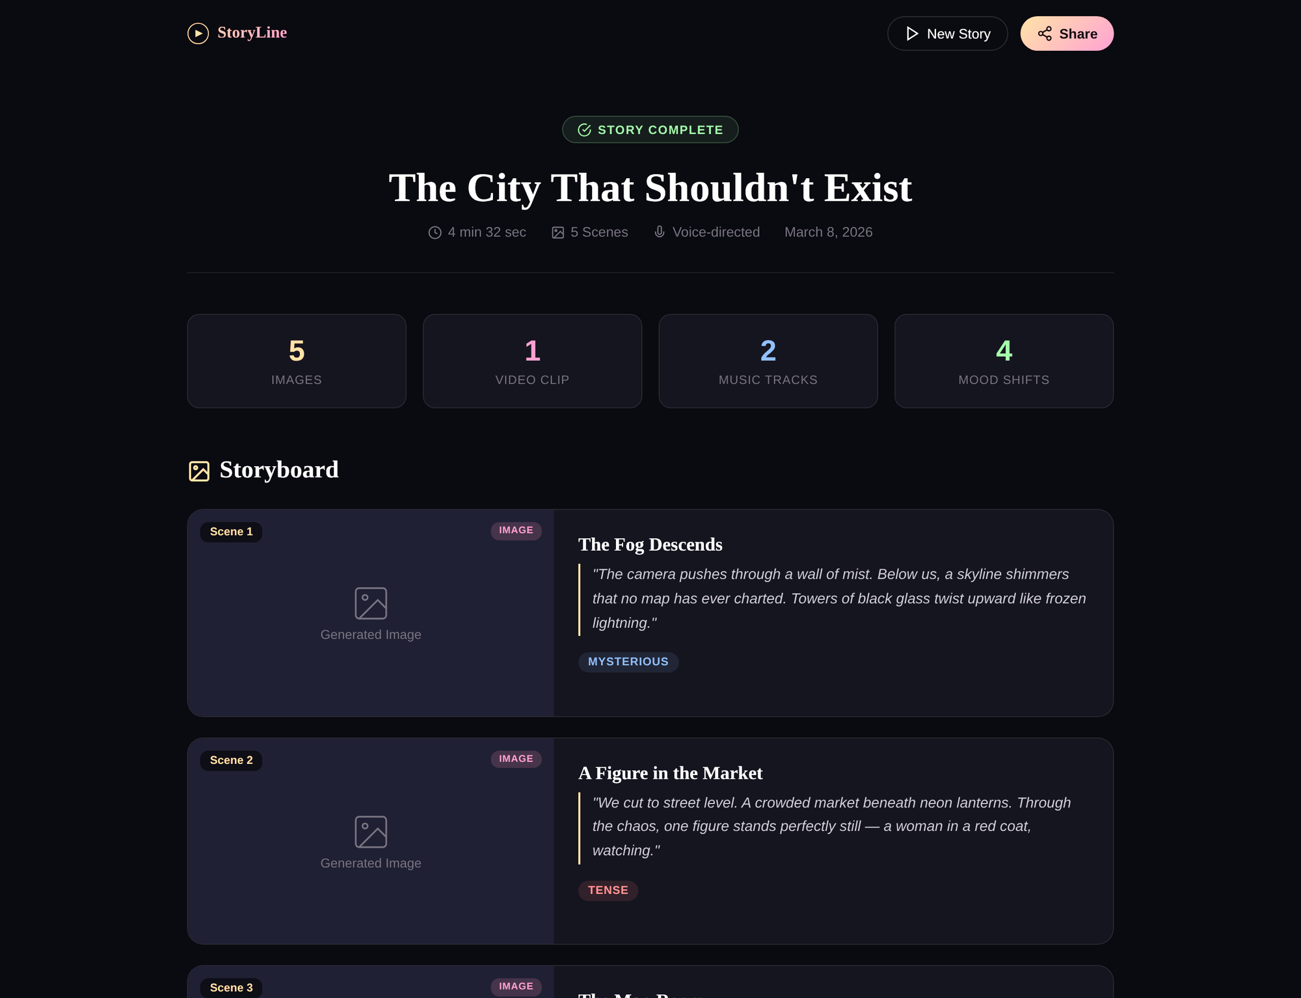
Generated Output
"The City That Shouldn't Exist" — created by voice in 4 minutes
storyline.app/output
9 / 10

Slide 11


The Future of Storytelling
is spoken, not typed
Indie Filmmakers
Educators
Concept to storyboard in minutes, not months
Bring any lesson to life with immersive stories
Content Creators
Everyone
Generate cinematic content from a single voice prompt
No technical skills needed — just speak
Try Dream Studio
Speak your story. See it come to life.
Google Cloud
Gemini 2.5 Flash
Imagen 4
Veo 3.1
Lyria 2
Google ADK
Thank you | Columbia University | March 2026
10 / 10

Slide 12
Thank You
Let's bring stories to life
Try StoryLine
Speak your story. See it come to life.
fff
Brought to you by
Maruthi
Kunchala
Siddhant Rajhans
Prakhar
Tripathi
Anugya
Sharma
Vignesh Prasad
Google Cloud
Gemini 2.5 Flash
Imagen 4
Veo 3.1
Lyria 2
Google ADK
Columbia University | Google Cloud x Gemini AI Hackathon | March 2026
GO DUCKS

